Slide 1
CONSUMER BEHAVIOUR AND RATIONAL CHOICE
MGCR 293
Professor: Dr. K. Salmasi
Dr. Taweewan Sidthidet
Dr. Tariq Nizami
T.A.: Mike Brintnell
Presentation Credit: Brianna Mooney

Slide 2
Agenda
Lecture Review:
Indifference Curves
MRS
Budget Lines
Market Bundles
Corner Solutions
Chapter Questions

Slide 3
CHAPTER REVIEW

Slide 4
MARKET BASKETS
A Market basket is a collection of one or more goods
Consumers always prefer more of the same goods to less goods
Consumers can prefer one market basket over another due to the composition of goods
Preferences can be compared and rank-ordered
Preferences are transitive-If you prefer A to B and B to C, you prefer A to C
Indifference may exist because the consumer gains equal satisfaction with both market baskets.
Diminishing marginal utility; there is a decrease in marginal utility with each additional unit consumed

Slide 5
INDIFFERENCE CURVES
Contains points representing market baskets among which the consumer is INDIFFERENT as each market basket on the curve represents equal utility/satisfaction
Consumer may have many indifference curves, the higher ones are the most preferred Indifference curves.
Indifference curves cannot intersect
They must slope downward
You will always want to move to a higher indifference curve

Slide 6
Food
L
M
100
K
50
I₂
I₁
0
Clothing
2
5
6

Slide 7

MARGINAL RATE OF SUBSTITUTION
The marginal rate of substitution of product X (measured on the horizontal axis) for product Y (measured on the vertical axis) is equal to the number of units of product Y that must be given up to get an extra unit of product X and maintain a constant level of utility.
MRS= slope of the indifference curve * -1 OR
A high MRS will make indifference curves relatively steep
A low MRS will make indifference curves relatively flat

Slide 8
16
A
Clothing
(units
per week)
14
MRS = 6
12
-6
10
B
1
8
-4
D
MRS = 2
6
1
-2
E
4
G
1
-1
2
1
Food (units per week)
1
2
3
4
5

Slide 9
Style
Style
Y
Y
I₃
A
I₂
I₃
A
B
B
I₂
I₁
I₁
I₁
0
0
Performance
X
X
Performance

Slide 10
SUBSTITUTES & COMPLEMENTS
Perfect Substitutes:
The indifference curve for perfect substitutes will be linear, connecting equal amounts for Good X and Good Y
Perfect Complements:
The indifference curve will have an L-shape, meaning that increases in utility occur when goods are consumed in constant proportion
VS

Slide 11
Perfect Substitutes
Apple
Juice
(glasses)
4
3
2
1
Orange Juice
(glasses)
0
1
2
3
4

Slide 12
Perfect Complements
Left
Shoes
4
3
2
1
Right Shoes
0
1
2
3
4

Slide 13
UTILITY
The numerical score representing the satisfaction that a consumer achieves from consumption
Assigning utility values allows us to rank order market baskets/consumption choices
Total utility is the aggregate sum of satisfaction or benefit that an individual gains from consuming a given amount of goods
Marginal utility is the derivative of total utility and represents the additional satisfaction or utility gained from one extra unit of consumption

Slide 14
LAW OF DIMINISHING UTILITY
The Law of Diminishing Marginal Utility stipulates that marginal utility decreases with each additional increase in consumption of a good (i.e. eating too many doughnuts)
Total utility, however, usually continues to increase as consumption increases.

Slide 15
UTILITY-MAXIMIZING RULE
The marginal utility/dollar spent on each product should be equal for the combination of goods in a given market basket:
MU_{x} = MU_{y}
P_{x} P_{y}
Objective of the Consumer:
Maximize utility with a given budget constraint

Slide 16
https://www.youtube.com/watch?v=kA4pEId7ysk

Slide 17
THE BUDGET CONSTRAINT
Indicates the market basket that a consumer is able to purchase given a budget and prevailing conditions
I=X(P_{x}) + Y(P_{y})
I represents income
X represents the quantity of good X consumed
Y represents the quantity of good Y consumed
P_{x} is the price of good X
P_{y} is the price of good Y
Y=(I/P_{y})-(P_{x}/P_{y})X

Slide 18
Food
Income = $600 / week P_{f} = $6 (Price of a pound of food)
P_{c} = $30 (Price of a piece of clothing)
(pounds)
100
Budget Line
0
Clothing (pieces)
20

Slide 19
Changes in the Budget Constraint:
If income increases, the budget line shifts outward so more of Good X and Good Y can be purchased to increase total utility. Vice versa.
When P_{x} or P_{y} increases, the budget constraint will pivot (change in slope) due to the decline in the amount of Good X or Good Y that can be purchased with a given budget. Vice versa.

Slide 20
http://www2.econ.iastate.edu/classes/econ532/hennessy/lectures/chap04/sld007.htm

Slide 21
EQUILIBRIUM MARKET BASKETS
The consumer will choose the market basket at the point of tangency between the budget line and the highest indifference curve (that is possible to consume on given the budget constraint)
This point represents the highest utility that can be achieved given this budget
The slope of the indifference curve at this point equals the slope of the budget line

Slide 22
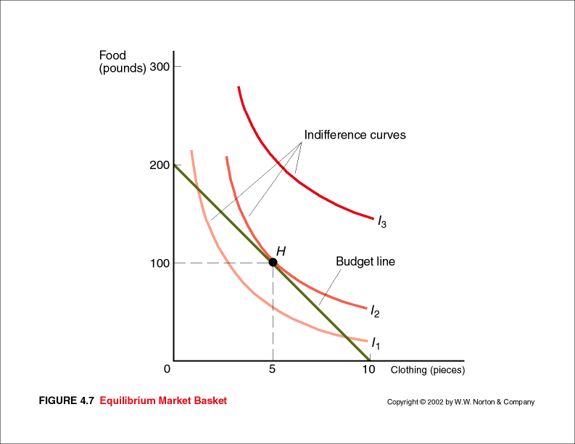
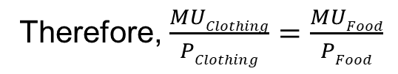
Therefore, at the tangency point, MRS=slope of the budget line or (Px/Py)
MRS= (Px/Py)
*where P_{x} is the price of the good on the X-Axis, and P_{y} is the price of the good on the Y-Axis
Therefore, $\frac{MUClothing}{PClothing}=\frac{MUFood}{PFood}$

Slide 23
CORNER SOLUTIONS
The consumer may consume none of some goods and therefore the market basket with the maximum utility will contain only one good
At this point, you choose the highest indifference curve that touches the budget line at the axis of the preferred good
Corner solutions often occur when the MRS cannot be equated to (Px)/(Py), implying that the indifference curve and the budget line are not tangent in a corner solution.

Slide 24
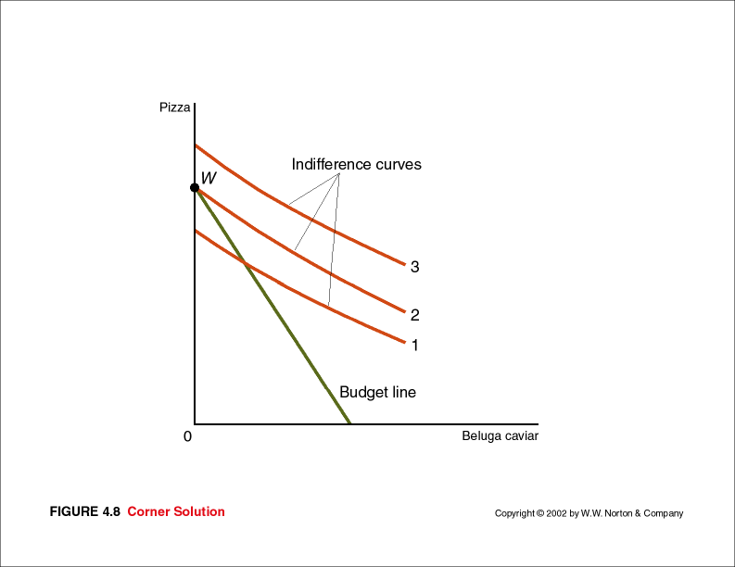

Slide 25
CORNER SOLUTIONS
If the slope of the indifference curve is steeper than the slope of the budget line, you will choose a corner solution that is a market basket consisting of only the good on the x-axis
If the slope of the budget line is steeper than the slope of the indifference curve, you will choose a corner solution that is a market basket consisting of only the good on the y-axis

Slide 26
https://www.youtube.com/watch?v=-ZvkM6Sm8HM
CORNER SOLUTIONS

Slide 27
MANAGING CONSUMER CHOICE
Managers can influence consumer behaviour through pricing policies or advertising strategies
Cash Discounts (i.e. coupons)
Quantity Discounts (I.e. 1 for $2, 3 for $5)

Slide 28
CONSUMER SURPLUS
The Consumer reservation price is the price that consumers are willing and able to pay for a certain good or service
Consumer surplus is the difference between the consumer reservation price and the equilibrium market price of a good or service
Consumer surplus is a measure of the efficiency of markets and the social benefits of market transactions
Managers attempt to capture consumer surplus through sophisticated pricing policies that aim to charge each consumer what they are willing and able to pay

Slide 29
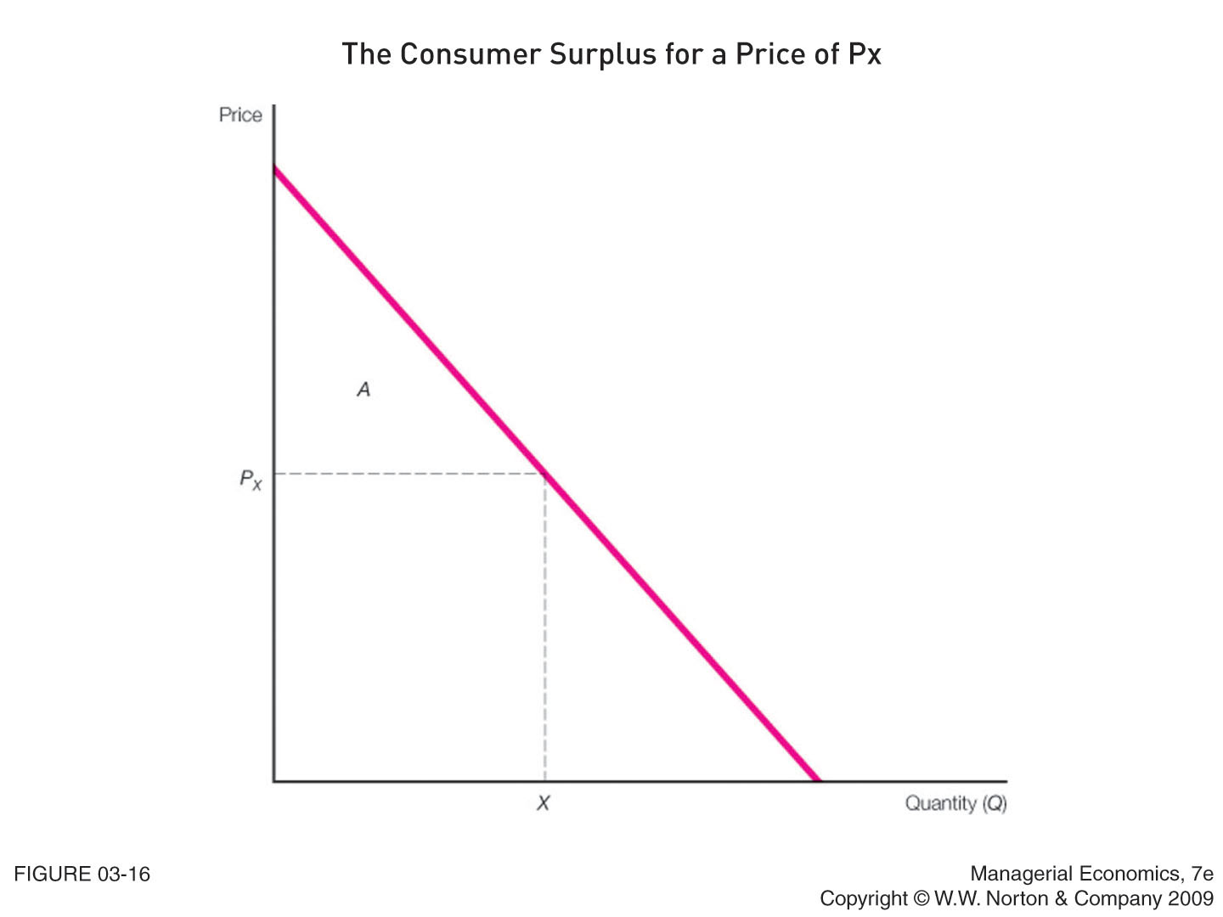

Slide 30
HOMEWORK SOLUTIONS

Slide 31
QUESTION 1
A market for sports performance drinks experienced a big shift in 2008 as sales of low-calorie sports drinks grew by over 25%. Many attributed this shift to greater use by women who wanted a sports drink without many calories.
a) If a woman desires two containers of low-calorie sports drink as much as one container of high-calorie sports drink, what do her indifference curves (between low- and high-calories sports drinks) look like?

Slide 32
SOLUTION 1
Since she has indicated that she receives equal utility from 1 high calorie sports drink, or 2 low calorie sports drinks, her indifference curve is a straight line, where MRS=2
Low Calorie
2
0
1
High Calorie

Slide 33
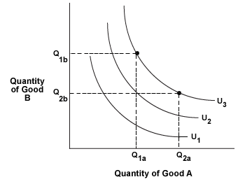
B) Do they have the typical shape of indifference curves? Why or why not?
No. Typically, the MRS changes as you move along the curve due to the law of diminishing marginal utility:

Slide 34
QUESTION 2
One problem with bagels is that they get stale fast. In the words of Ray Lahvic, editor emeritus of Bakery Production and Marketing, “the worst thing in the world is a day-old bagel.”
If a market researcher asserts that the slope of the typical consumer’s indifference curves between fresh and day-old bagels is -1, would you agree with this assertion? Why or why not?

Slide 35
SOLUTION 2
Disagree. If the slope of the indifference curve between stale and fresh bagels is -1, this indicates that one would gain equal satisfaction substituting one new bagel for one stale bagel

Slide 36
QUESTION 3
Plot the quantity of lamb consumed along the vertical axis and the quantity of rice consumed along the horizontal axis. Draw the indifference curve that includes the following market bundles:
Market Bundle | Lamb (Pounds) | Rice (Pounds
1 | 2 | 8
2 | 3 | 7
3 | 4 | 6
4 | 5 | 5
5 | 6 | 4
6 | 7 | 3
7 | 8 | 2
8 | 9 | 1

Slide 37
SOLUTION 3
Lamb (lbs)
10
8
6
4
2
0
2
8
4
6
10
Rice (lbs)

Slide 38
QUESTION 4
In the previous question, what is the marginal rate of substitution of rice for lamb? How does the marginal rate of substitution vary as Ms. Turner consumes more lamb and less rice? Is this realistic?

Slide 39
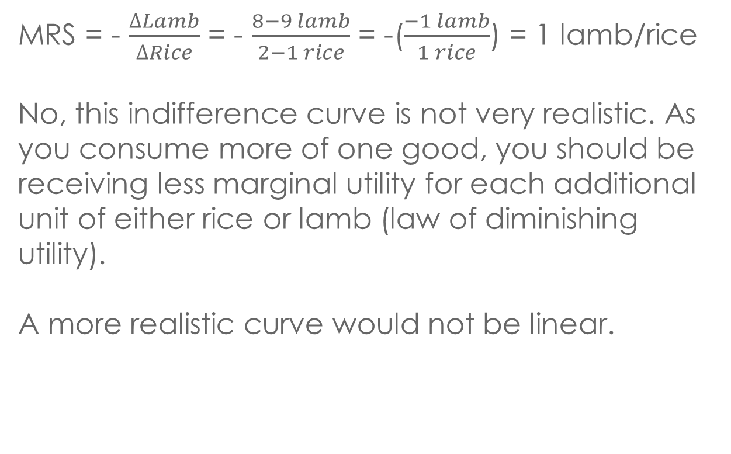
SOLUTION 4
MRS = - $\frac{∆Lamb}{∆Rice}$ = - $\frac{8−9 lamb}{2−1 rice}$ = -($\frac{−1 lamb}{1 rice}$) = 1 lamb/rice
No, this indifference curve is not very realistic. As you consume more of one good, you should be receiving less marginal utility for each additional unit of either rice or lamb (law of diminishing utility).
A more realistic curve would not be linear.

Slide 40
QUESTION 5
Suppose Richard has an after-tax income of $500 per week and must spend it all on food or clothing.
If food is $5 per pound and clothing is $10 per piece, draw his budget line, where the amount of food is measured along the vertical axis and the amount of clothing is measured along the horizontal axis.

Slide 41
SOLUTION 5
Quantity of Food at Y-intercept
= Income/Price of Food
Quantity of Clothing at X-intercept
=Income/Price of Clothing
Food
100
0
50
Clothing

Slide 42
QUESTION 6
In the previous problem, what is the budget line if Richard’s weekly income increases to $600?
What is his budget line if income is $ 500 but the price of food increases to $10 per pound?
What is his budget line if his income is $500 but the price of clothing increases to $20 per piece? Draw the curves

Slide 43
SOLUTION 6a
Food
New Y-intercept Quantity of Food= $600/Price of Food
New X-Intercept Quantity of Clothing
=$600/Price of Clothing
120
100
0
50
60
Clothing

Slide 44
SOLUTION 6b
Food
Income=$500
Price of Food= $10/unit
Price of Clothing= $10/unit
New Y-Intercept= $500/($10/unit)=50 units
100
50
0
50
Clothing

Slide 45
SOLUTION 6c
Food
Income=$500
Price of Food=$5/unit
Price of Clothing=$20/unit
New X-Intercept = $500/($20/unit) = 25 units
100
0
25
50
Clothing

Slide 46
QUESTION 7
Maria has budgeted a total of $9 to spend on two goods: chips and salsa.
She likes to consume a unit of chips in combination with a unit of salsa.
Any unit of chips that she cannot consume in combination with a unit of salsa is useless.
If the price of a unit of chips is 50 cents and the price of a unit of salsa is 10 cents. How many units of each good does she purchase?

Slide 47
SOLUTION 7
Let X represent the quantity of chips units consumed
Let Y represent the quantity of salsa units consumed
Since Maria cannot eat a unit of chips without eating a unit of salsa, we know that she will consume equal amounts of each
Therefore, x=y
$9=P_{x}(x) + P_{y}(Y)
$9=0.5X + 0.1Y, where X=Y
$9=0.5X+0.1X
$9=0.6X
X=15 units, therefore Y=15 units

Slide 48
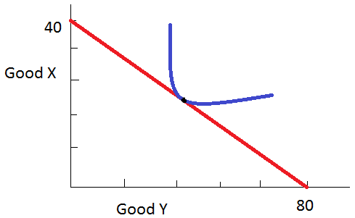
QUESTION 8
Given Jane’s indifference curve and budget line,
a) If the price of good X is $100, what is her income?

Slide 49
SOLUTION 8a
Income= P_{x}(X) + P_{y}(Y)
Looking at the graph, we know that when Jane allocates her entire budget to good X, costing $100, she is able to consume 40 units
Income=Px(0) + $100(40)
Income=$4,000

Slide 50
Question 8b,c,d,e
What is the equation of her budget line?
What is the slope of her budget line?
What is the price of good Y?
What is Jane’s marginal rate of substitution in equilibrium?

Slide 51
SOLUTION 8b
The equation for the budget line:
Income = Px(x) + Py(y)
4,000= $50(x)+ $100y
4000-50x=100y
Y=40 – 0.5x
We calculate the $50 price of the good on the x-axis by dividing the total income by the number of units consumed on the x-axis
NOTE: Check your Axis! Good Y is actually on the X-axis, and Good X on they Y-axis.

Slide 52
SOLUTION 8
c) Slope of Budget Line= -Px/Py
=-$50/$100
=-0.5
d) Price of Good Y (the good on the x-axis) =Income/Quantity of Good Y, $4000/80=$50
e)MRS= -1* slope of budget line
=(Px/Py)=0.5
In equilibrium, the slope of the budget Line must equal the slope of the indifference curve. MRS= -1* slope of the indifference curve. Note that the slope of the budget line is constant, so we know what MRS will be in equilibrium.

Slide 53
QUESTION 9
Sarah has $300 to allocate between opera tickets and movie tickets. The price of each opera ticket is $60, and the price of each movie ticket is $6. Her marginal rate of substitution of opera tickets for movie tickets equals 5, regardless of what market bundle she chooses. How many opera tickets does she purchase?

Slide 54
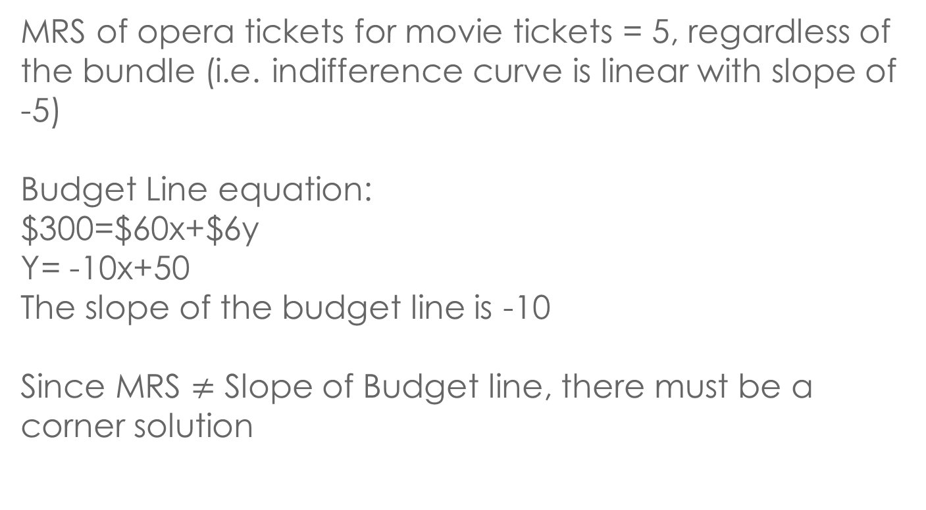
SOLUTION 9
MRS of opera tickets for movie tickets = 5, regardless of the bundle (i.e. indifference curve is linear with slope of -5)
Budget Line equation:
$300=$60x+$6y
Y= -10x+50
The slope of the budget line is -10
Since MRS $≠$ Slope of Budget line, there must be a corner solution

Slide 55
SOLUTION 9
Movie Tickets
50
Indifference Curve
Budget Line
0
5
10
Opera Tickets

Slide 56
SOLUTION 9
Since MRS is flatter than the slope of the budget line (also called the price ratio, Px/Py), the consumer will choose to consume only the good on the y-axis (ie: movie tickets).
Therefore, Sarah will spend her entire income ($300) on movie tickets, and purchase 0 opera tickets

Slide 57
QUESTION 11
In 1993 the state of New York received $3 billion to be spent during the mid-1990s on highways and/or mass transit, both which could be used to meet the transportation needs of the state’s population.
If each mile of mass transit costs $20 million, what is the maximum number of miles of mass transit that these funds would have enabled the state to construct?
If each mile of highway costs $10 million, what is the maximum number of miles of highway that these funds would have enabled the state to construct?

Slide 58
SOLUTION 11a
Total Budget = $3 Billion
Price of Mass Transit (P_{y}) = $20 Million
Price of Highway (P_{x}) = $10 Million
$3 Billion=P_{x}(x)+ P_{y}(y)
$3 Billion= $10 Million(0) + $20million(y)
Y=150 miles of mass transit

Slide 59
SOLUTION 11b
$3 Billion= $10 million(x) + $20 million (0)
X= 300 miles of highway

Slide 60
SOLUTION 11c
c) Draw the budget line given the previous data and state the slope
Mass transit (miles)
Slope of budget line = -Px/Py
= -$10 million/$20million
= -0.5
150
0
Highways (miles)
300

Slide 61
SOLUTION 11d
d) If the public and the state agree that every extra mile of mass transit adds three times as much to the state’s transportation capability as an extra mile of highways, how much of the $3B should be spent on mass transit if the objective is to maximize transportation capability?

Slide 62
SOLUTION 11d
MRS= MU_{x}/MU_{y}
If the marginal utility of mass transit is 3 times the marginal utility of highways, MRS= 1/3 (mass transit is the y-axis good, and highways is the x-axis good)
If MRS of highways to mass transit=1/3, MRS does not equal Price Ratio (Px/Py)
Therefore, there will be a corner solution: since MRS of 1/3 is less than 0.5 (P_{x}/P_{y}), the budget will be allocated fully to the good on the y-axis, namely, mass transit.

Slide 63
Q&A

